Slide 1
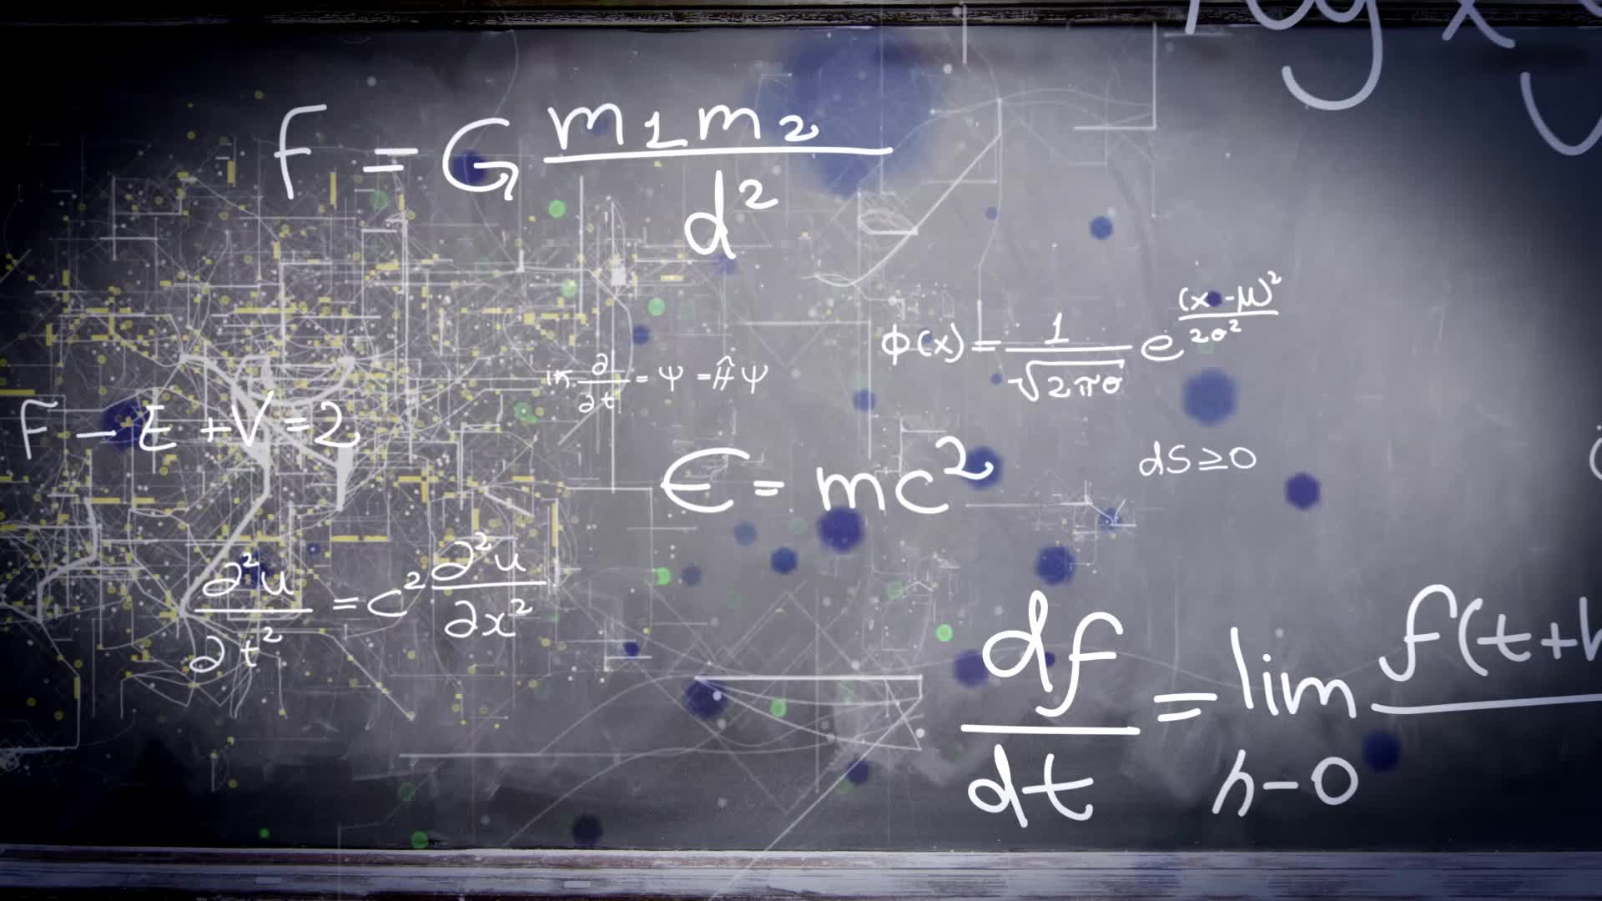
Chapter 2.4:
The Chain Rule
HONORS CALCULUS/CALCULUS

Slide 2
The Chain Rule
$$\frac{d}{dx}\left[f(g\left(x\right))\right]=f^{′}\left(g\left(x\right)\right)g′(x)$$
$$y={\left(x^{2}+1\right)}^{3}$$
$$y={\left(3x−2x^{2}\right)}^{8}$$

Slide 3
$$f(x)=\sqrt[3]{{\left(x^{2}+2\right)}^{2}}$$

Slide 4
$$g\left(t\right)=−\frac{7}{{\left(2t−3\right)}^{2}}$$

Slide 5
The Chain Rule and Product Rule
$$f\left(x\right)=x^{2}\sqrt{1−x^{2}}$$

Slide 6
The Chain Rule and Quotient Rule
$$f\left(x\right)={\left(\frac{3x−1}{x^{2}+3}\right)}^{2}$$

Slide 7
Alternate Method: Product Rule
$$f\left(x\right)={\left(\frac{3x−1}{x^{2}+3}\right)}^{2}$$

Slide 8
Quotient Rule
$$f\left(x\right)=\frac{x}{\sqrt[3]{x^{2}+4}}$$

Slide 9
Product Rule
$$f\left(x\right)=\frac{x}{\sqrt[3]{x^{2}+4}}$$

Slide 10
Derivates of Trigonometric Functions

Slide 11
Applying the Chain Rule to Trigonometric Functions
$$y=sin2x$$
$$y=cos(x−1)$$
$$y=tan3x$$

Slide 12
Applying the Chain Rule to Trigonometric Functions
$$y=cos\left(3x^{2}\right)$$
$$y=cos^{2}(3x)$$

Slide 13
Applying the Chain Rule to Trigonometric Functions
$$f(t)=\sqrt{sin4t}$$

